Slide 1
Noise Model in CMOS Image Sensor
Bofeng Cao
2024.7.25

Slide 2
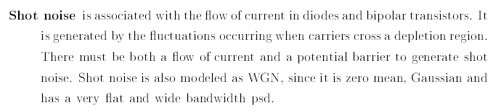

Shot Noise
By Hui Tian[1]:
Shot Noise Modeled by Yue Cao[2]:

Slide 3
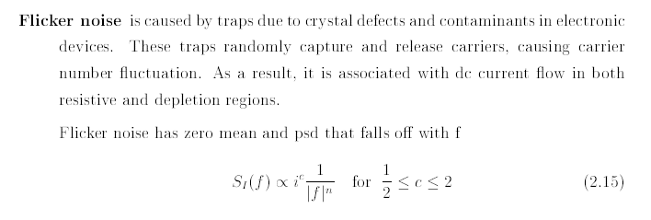
Flicker Noise
By Hui Tian[1]:

Slide 4
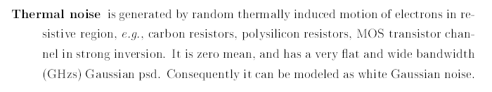
Thermal Noise
By Hui Tian[1]:

Slide 5
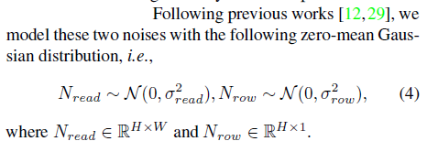
Read-Out Noise
By Emil Martinec[3]:
Noise Modeled By Yue Cao[2]:

Slide 6
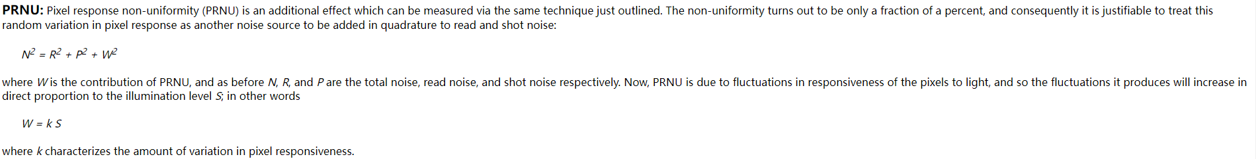
Fixed Pattern Noise(FPN)
Spatially correlated noise is collected due to the response of each pixel of the sensor.
Emil proposed one named PRNU(Pixel response non-uniformity):

Slide 7
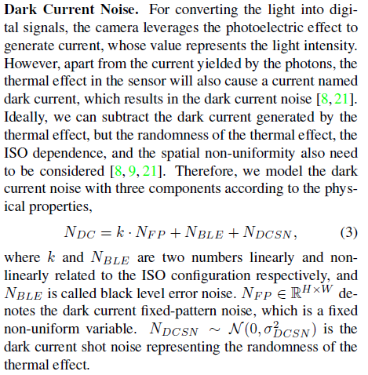
Special in Shot Noise: Dark Current Noise
By Yue Cao[3]:

Slide 8
Reference
[1] Y. Cao, M. Liu, S. Liu, X. Wang, L. Lei, and W. Zuo, "Physics-Guided ISO-Dependent Sensor Noise Modeling for Extreme Low-Light Photography," in 2023 IEEE/CVF Conference on Computer Vision and Pattern Recognition (CVPR)
[2] H. Tian, "Noise analysis in CMOS image sensors," Ph.D. dissertation, Dept. Appl. Phys., Stanford Univ., Stanford, CA, USA, 2000.
[3] E. Martinec, "Noise, dynamic range and bit depth in digital SLRs," *[Online]. Available: https://homes.psd.uchicago.edu/~ejmartin/pix/20d/tests/noise/index.html*. [Accessed: 25-Jul-2024].

